Slide 1
Modern Machine Learning — Learning Curves
Kenneth E. Barner
Department of Electrical and Computer Engineering
University of Delaware

Slide 2
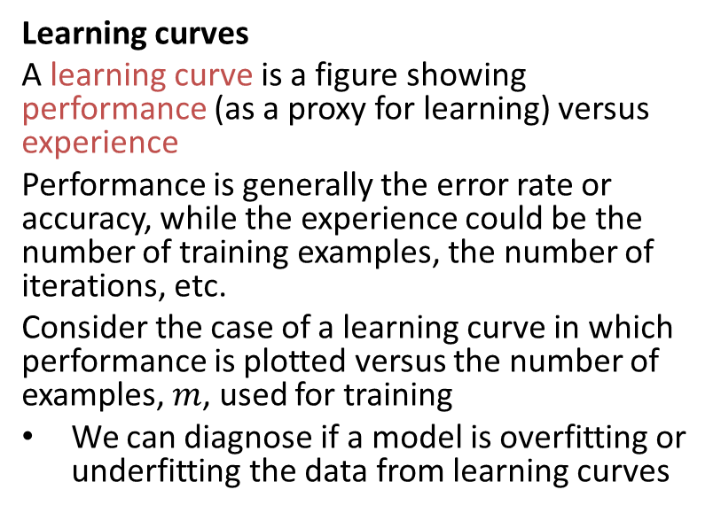
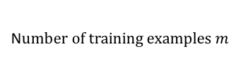


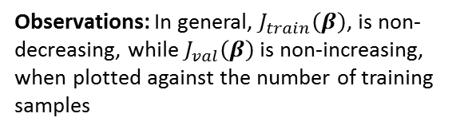
Learning Curves
Learning curves
A learning curve is a figure showing performance (as a proxy for learning) versus experience
Performance is generally the error rate or accuracy, while the experience could be the number of training examples, the number of iterations, etc.
Consider the case of a learning curve in which performance is plotted versus the number of examples, $m$, used for training
We can diagnose if a model is overfitting or underfitting the data from learning curves
Error
$$J_{val}\left(β\right)$$
$$J_{train}\left(β\right)$$
N$umber of training examples m$
Learning curve example
Observations: In general, $J_{train}\left(β\right)$, is non-decreasing, while $J_{val}\left(β\right)$ is non-increasing, when plotted against the number of training samples

Slide 3
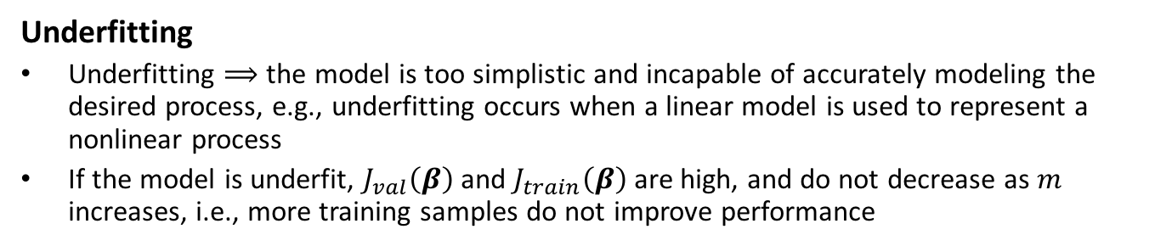
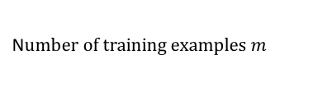







Learning Curves
Underfitting
Underfitting $⟹$ the model is too simplistic and incapable of accurately modeling the desired process, e.g., underfitting occurs when a linear model is used to represent a nonlinear process
If the model is underfit, $J_{val}\left(β\right)$ and $J_{train}\left(β\right)$ are high, and do not decrease as $m$ increases, i.e., more training samples do not improve performance
$$f(x)$$
$$f(x)$$
Error
$$J_{val}\left(β\right)$$
$$x$$
$$x$$
$$J_{train}\left(β\right)$$
$m$ small $→$ error large
$m$ large $→$ error large
For the case of underfitting, more training examples do not improve performance significantly
N$umber of training examples m$

Slide 4
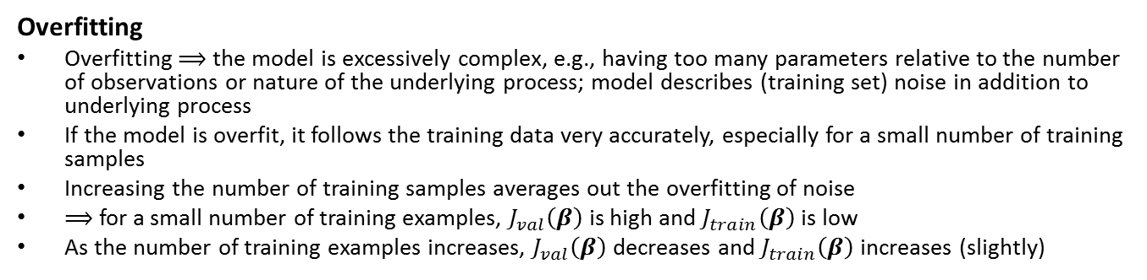








Learning Curves
Overfitting
Overfitting $⟹$ the model is excessively complex, e.g., having too many parameters relative to the number of observations or nature of the underlying process; model describes (training set) noise in addition to underlying process
If the model is overfit, it follows the training data very accurately, especially for a small number of training samples
Increasing the number of training samples averages out the overfitting of noise
$⟹$ for a small number of training examples, $J_{val}\left(β\right)$ is high and $J_{train}\left(β\right)$ is low
As the number of training examples increases, $J_{val}\left(β\right)$ decreases and $J_{train}\left(β\right)$ increases (slightly)
$$f(x)$$
$$f(x)$$
Error
$$J_{val}\left(β\right)$$
$$x$$
$$x$$
$m$ small $→$ error large
$m$ large $→$ error small
$$J_{train}\left(β\right)$$
For the case of overfitting, more training examples do improve performance
N$umber of training examples m$

Slide 5
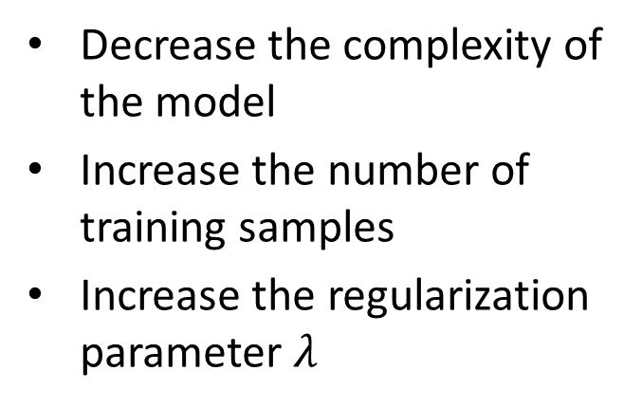
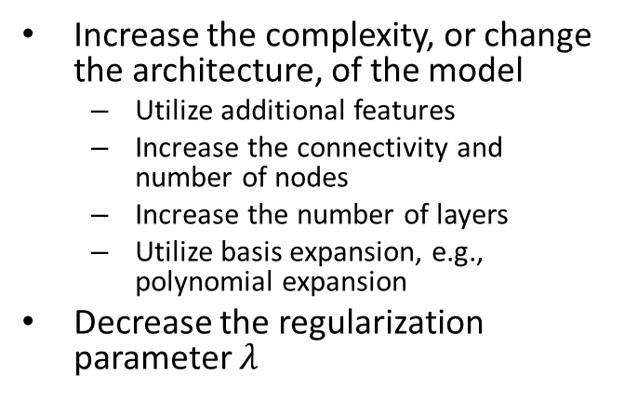
Learning Curves
Summary
To avoid overfitting
To avoid underfitting
Decrease the complexity of the model
Increase the number of training samples
Increase the regularization parameter $λ$
Increase the complexity, or change the architecture, of the model
Utilize additional features
Increase the connectivity and number of nodes
Increase the number of layers
Utilize basis expansion, e.g., polynomial expansion
Decrease the regularization parameter $λ$

